Slide 1
Risks for Coronary Heart Disease

Slide 2

Introduction
Heart disease is the leading cause of death in the USA.
State and local public health organizations have limited resources.
To make the most of small budgets, need to target most at-risk populations.

Slide 3
The Methodology and Data Science Process
Ask an interesting question
Get the data
Explore the data
Analyze the data
Visualize the results
Notes:
1.Do patients who developed CVD have a higher systolic blood pressure on average compared to patients who did not develop CVD?
2.Are patients who developed CVD on average older compared to patients who did not develop CVD?
3.Are patients with prediabetic and diabetic levels of glucose related to developing CVD?
Get the data: We clean and plot the data

Slide 4
Research Objective
Objective:
To understand what is the top risk factors for coronary heart disease.
Questions:
Are patients who developed CHD on average older compared to patients who did not develop CHD?
Do patients who developed CHD have a higher systolic blood pressure on average compared to patients who did not develop CHD?
Notes:
Add dataset background

Slide 5
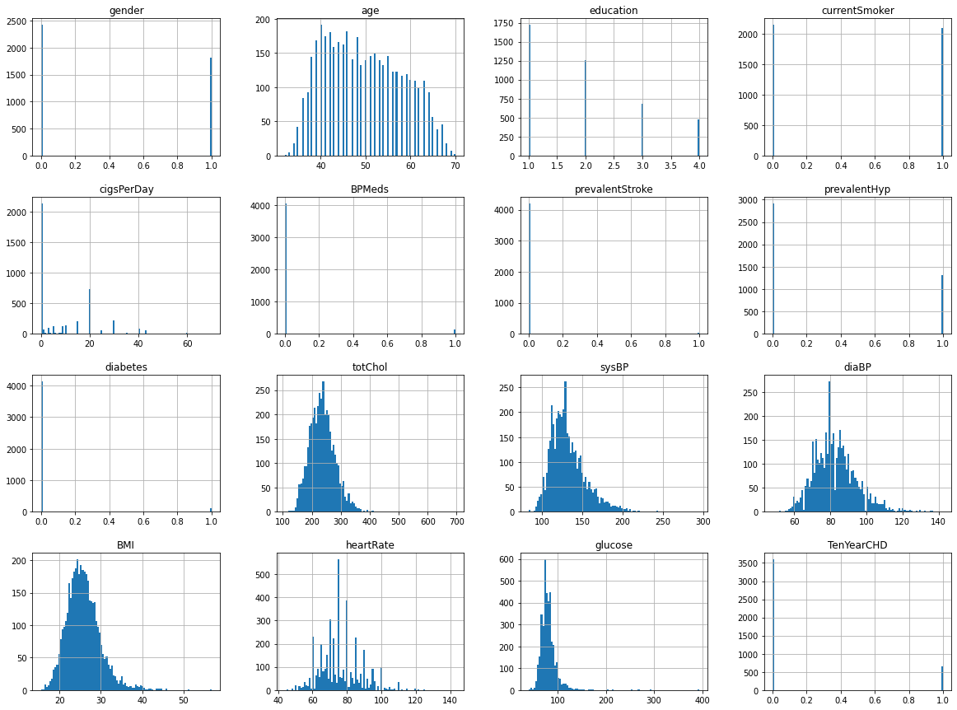
Exploratory Data Analysis
Data set description
The dataset has some historical and current data for 4,238‬ patients and the features are as follows:
Demographic: male (gender), patient's age, education
Behavioral: The average number of cigarettes consumed by the patient every day, or whether the patient is a smoker or not.
Medical (history): illustrates what kind of serious diagnoses that the patients experience in the past.
Medical (Current): the current measurement of the patients in terms of total cholesterol level, systolic blood pressure, diastolic blood pressure, body mass index, heart rate, glucose level, and the risk of getting Coronary Heart Disease (CHD) in the next 10 years.
Notes:
Before analyzing the data we should first look at the missing values. Initially these missing values can be removed since they are very little comparing to the total number of records that we have (4238 instances), and most of them can't be filled with the mean or median of the column as they are diagnosis and can be different from one patient to another.

Slide 6
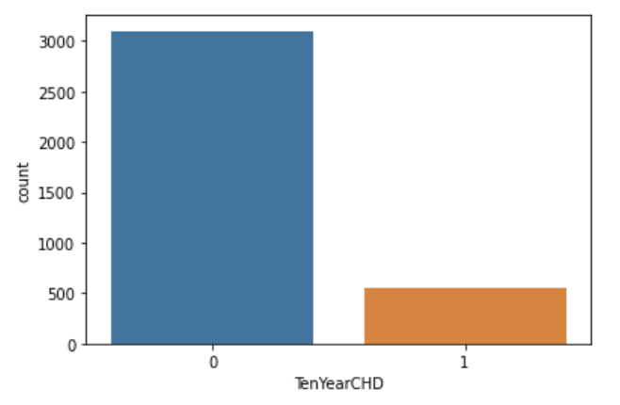
The distribution of the target column (TenYearCHD)
As can be seen from the distribution of the target column, there are 557 patients who developed CHD in the next ten years. However, 3099 patients did not develop CHD.

Slide 7
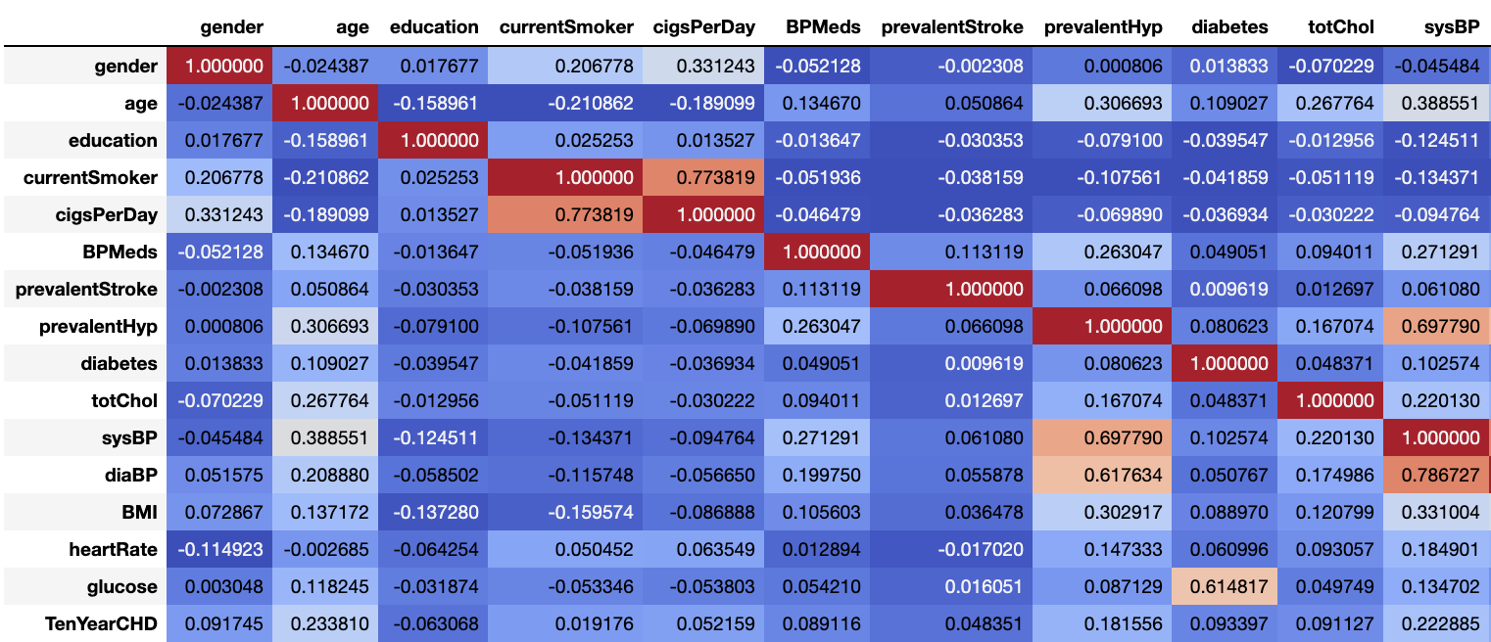
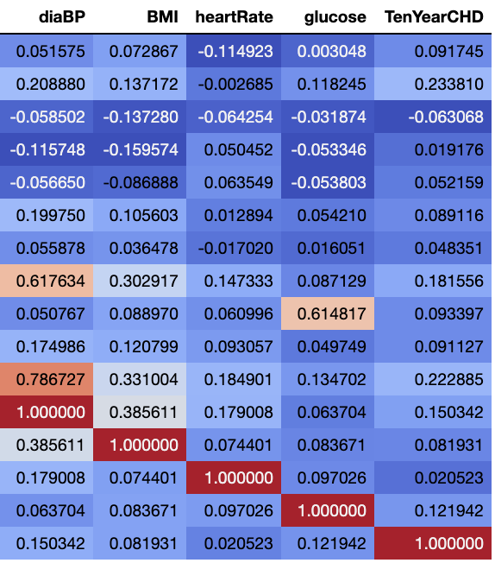
Correlation Matrix
Notes:
Looking at the correlation matrix, there are some correlations between columns.
Correlation between TenYearCHD and sysBP as well as TenYearCHD and age (considerable, but not very strong)
Correlation between prevalentHyp and sysBP (strong)
Correlation between diaBP and sysBP (strong)
Correlation between diabetes and glucose
Correlation between prevalentHyp and diaBP(strong)
Correlation between currentSmoker and cigsPerDay(strong)

Slide 8
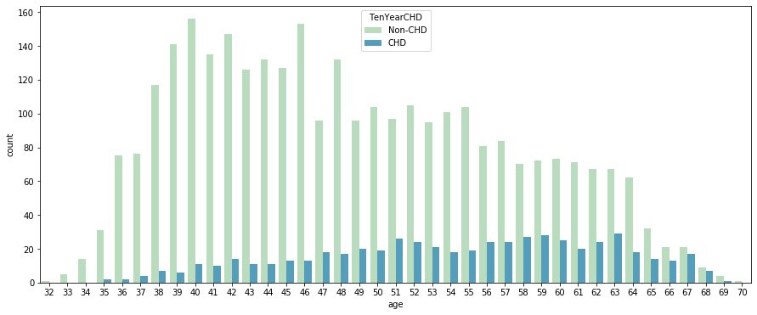
Number of people who have heart disease according to age
Notes:
Of the variables associated with CHD, Age had the strongest correlation, followed by blood pressure and blood sugar.
This graph shows the age distribution between patients who developed CHD and those who didn’t. As you can see in the dark blue shows that the age distribution among patients who develop CHD skews older.

Slide 9
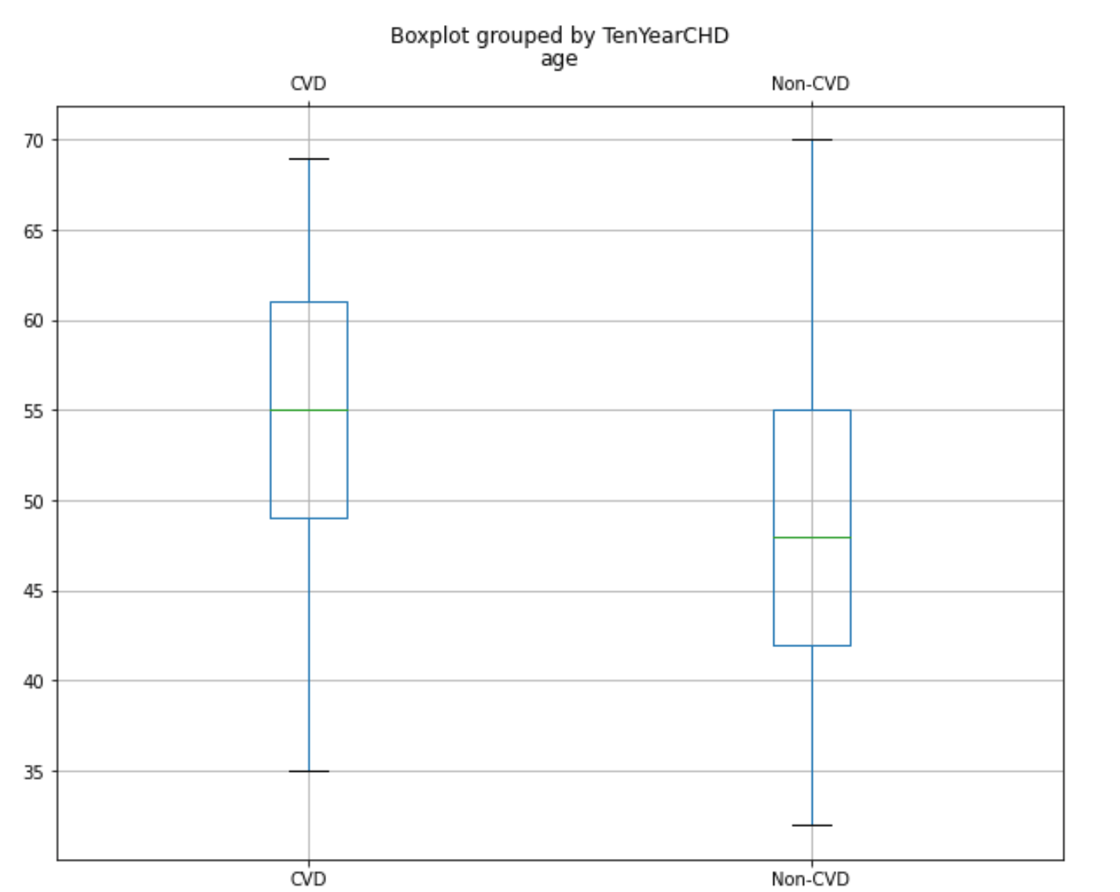
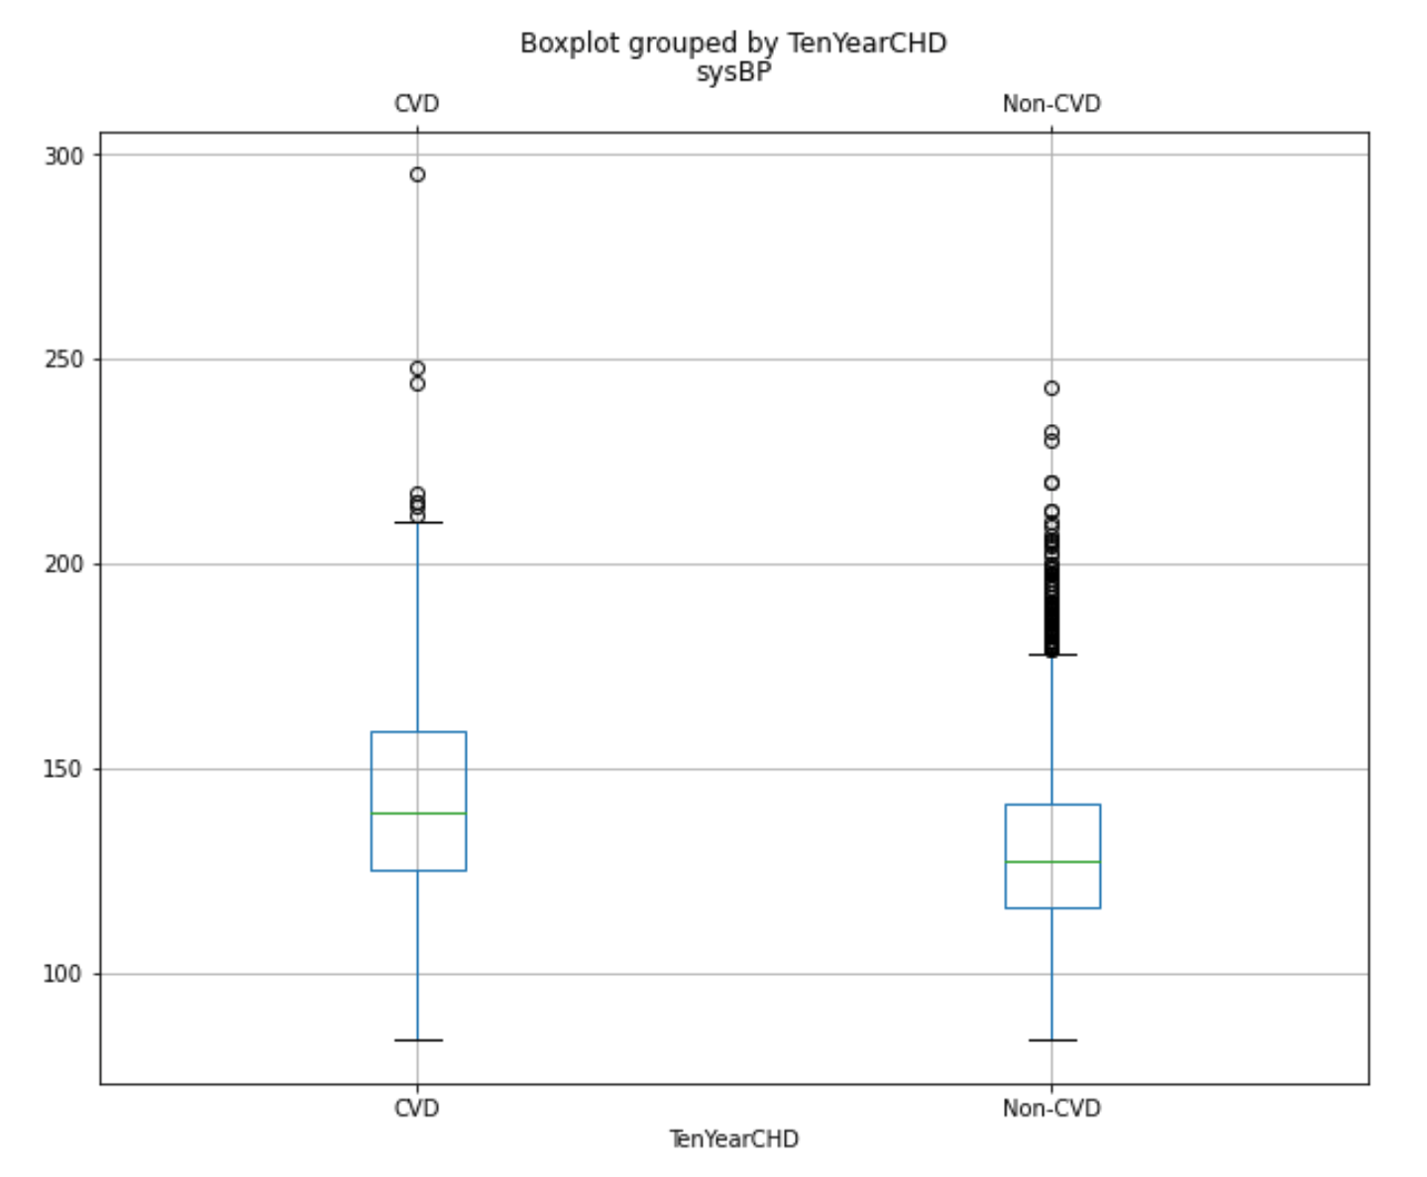
Results (Descriptive Statistic)
Patients | 95%C.I (age) | 95% C.I (sysBP) | Age_mean (std) | SysBP_mean (std)
CHD | 53.61-54.94 | 141.74-146.22 | 54.28(7.99) | 143.98(26.96)
Non_CHD | 48.40-48.99 | 129.57-131 | 48.7(8.38) | 130.28(20.41)

Slide 10
Result(statistic to test Hypothesis and answer question)
Question | Considering CHD Non_CHD patients, do CHD have higher sysBP mean than Non CHD Patients? | Considering CHD-Non CHD patients, do CHD and non-CHD patients differ significantly in mean age?
Null Hypothesis | There is no difference in mean sysBP | There is no difference in mean age
Alternative Hypothesis | There is a significant difference in mean sysBP | There is a significant difference in mean age
Significance level | 5% | 5%
Test | Z Test | Z Test
P value | 1.922670905699858e-43 | 5.698450859102773e-48
Conclusion | Reject the Null.There are significant difference | Reject the Null.There are significant difference

Slide 11
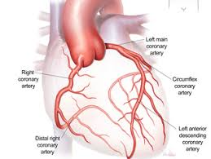
Age as a Confounding Variable
sysBP
CHD
Age
Notes:
the increase in blood pressure with age is mostly associated with structural changes in the arteries and especially with large artery stiffness. Age-related increases in blood pressure have been observed in almost every population.

Slide 12
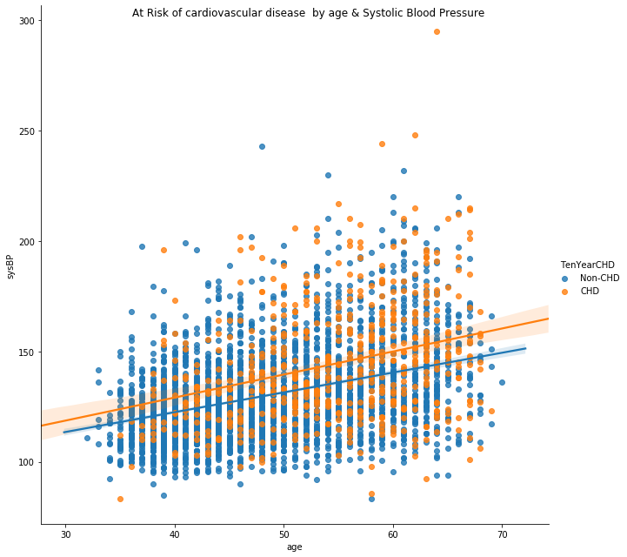
Notes:
Age-related increase in blood pressure have been observed in almost every population. So we did correlation and linnear regression.
.for our visualization purpose will fit line using seaborn library only for age as independent variable
and sysBP as dependent variable. In above plot we fit regression line into the variables.
Through this regression analysis we found that for every year someone ages, their blood pressure increases by 1. The R squared value was .38 meaning age explains just under 40% of the variation in systolic blood pressure.

Slide 13

Conclusion
Older age poses the highest risk for developing coronary heart disease.
High blood pressure also presents high risk, but can be partially explained by age.
State and local public health officials should focus on elderly populations with high blood pressure as they are most at risk.

